Slide 1

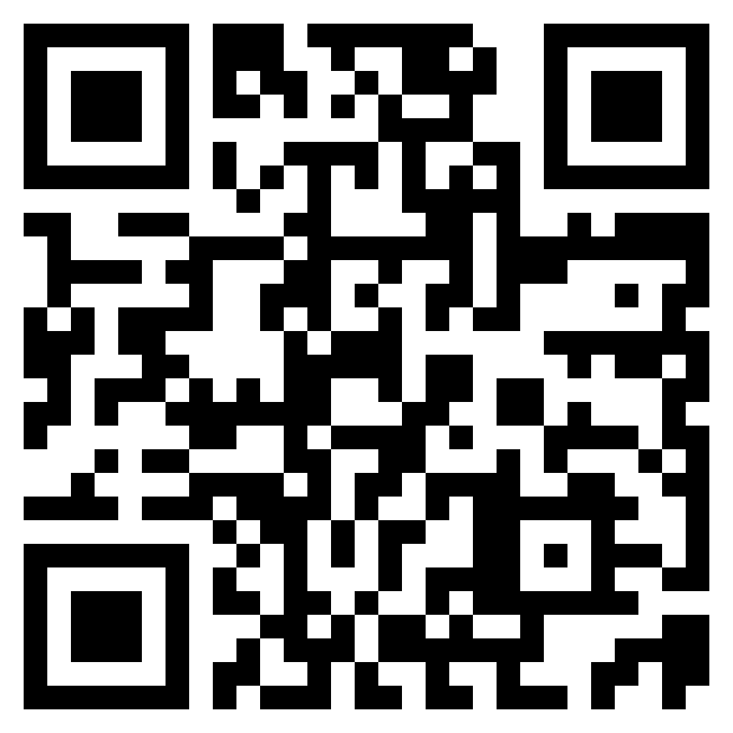
CSE 8A – Introduction to Programming and Computational Problem Solving I
Functions and LLM WorkFlow
Class Website
https://sites.google.com/ucsd.edu/cse8afa23/home
Slides based, in part, on materials from Dan Zingaro.
Notes:
Welcome!

Slide 2
Announcements
Complete HW0 (on canvas) due tomorrow:
Complete the syllabus quiz (#FinAid) on canvas
Complete the Academic Integrity Agreement Form
Complete “setting up your environment” and submit on gradescope
Also complete the “Practice Lab Exercise” to make sure Copilot is working for you on PrairieLearn for lab tomorrow.
There’s also a check to make sure Copilot is working for your lab tomorrow.
Complete the “Pre-Class Getting to know you survey”
Attend Lab tomorrow in your assigned section
May need your student ID and could be helpful to have your laptop
Arrive 5 minutes early to ensure you can start the lab on time
Can start homework 1, but more details provided in the lab on Wednesday and class on Thursday
Notes:
Mention extension for students joining the class late

Slide 3
Learning Goals for Today
By the end of today’s lecture, you should be able to:
Identify the parts of a function signature
Determine what a function should take in as input (parameters) and output (return values)
Call a function properly

Slide 4
Functions!
Functions are useful for code duplication
Without a function, you might have to paste the same or similar code multiple times – increases code length
Without a function, it’s hard to fix code if you want to change it
Functions are useful for breaking down a problem into smaller, more manageable chunks (top-down design)
Absolutely critical for cognitive load

Slide 5
Functions in math
f(x) = x³
If x is 4, what is f(x)?
4
7
16
64
None of the above
Notes:
64

Slide 6
Functions in math
f(b,h) = (b*h)/2
What is this function?
If I program it into my graphing calculator, I can just give it the values of b and h and it’ll give me back the value. I don’t need to type (b*h) /2 anymore.
Notes:
64

Slide 7
Let’s create this function in python!
Notes:
Demo creating the function

Slide 8
Defining functions in Python
Keyword that this is a function
Name of function
Parameter List
def area_triangle(base, height):
return 0.5 * base * height
Keyword that we’re returning something
Notes:
Call

Slide 9
And the syntax of a function declaration
def area_triangle(base, height):
return 0.5 * base * height
Notes:
Point out def, space, name (must be 1 word and avoid special characters), parenthesis, parameter list with commas, again single words, end parantheis, colon
Indent the body of the function

Slide 10
Understanding Variables
Parameter List
def area_triangle(base, height):
return 0.5 * base * height
Literal value
Use of variables
Notes:
Call

Slide 11
CS Concepts: Variables
A variable is a location in memory with an associated name. Stored in memory is a reference (pointer) to an object that (behind the scenes in Python) has a type.
value = 3
decimal = 6.5
name = "Leo"
Careful, can’t be a smart quote, i.e., “Leo”
Note: Strings are special, we’ll see more of them as the quarter goes on.
Notes:
Int, float, string

Slide 12
CS Concepts: Variables
Variables can be assigned values. This changes the object pointed to by their memory location. In Python, a variable can point to an object of any type.
first = 5
second = 10
first = second
second = second + 4
What is the value stored in second when this code is finished?
4
10
9
14
This code causes an error
Notes:
Wait on the memory model for now – just say, let’s think through another example

Slide 13
CS Concepts: Variables
Variables can be assigned values. This changes the object pointed to by their memory location. In Python, a variable can point to an object of any type.
first = 5
second = 10
first = second
second = second + 4
What is the value stored in first when this code is finished?
10
14
5
15
This code causes an error
Notes:
Draw memory models – Write, int objects are immutable but references are mutable.

Slide 14
CS Concepts: Variables
Variables can be assigned values. This changes the object pointed to by their memory location. In Python, a variable can point to an object of any type.
first = 5
second = first
first = "Hi"
Changing the type of the object being pointed to is legal in Python – it isn’t in languages like Java.
Notes:
Draw memory models

Slide 15
CS Concepts: Variables
Some common types in Python
Numeric data types: int, float, complex
String data types: str
Boolean type (True or False): bool
Sequential collections of values: list, tuple, range
More to come!
Notes:
Int, float, string

Slide 16
Adding local variables to our function
Notes:
Demo changing the function to have a temporary variable. Talk about variables vs. parameters

Slide 17
CS Concepts: Commenting
Not everything you type is a Python command. To write a comment you can use a # symbol, e.g.:
# output hello world
Or you can use a docstring. Docstrings are more apt to have the LLM generate code at the end of the docstring, whereas comments sometimes just get more comments suggested.
"""
output hello world
"""

Slide 18
CS Concepts: Commenting
Comments can be used to describe what your code does for a human reader
although you should only be commenting confusing part of code under the principle your code should be so well written it is “self commenting”
Or you can use comments to prompt Copilot to give you code that you are requesting
Understanding how to “speak” to the LLM is called prompt engineering

Slide 19
Understanding Functions

Slide 20
So, how do we set the values for parameters then?
Parameter List
def area_triangle(base, height):
return 0.5 * base * height
Use of variables
Notes:
Need to call the function with values

Slide 21

Calling a function
def area_triangle(base, height):
return 0.5 * base * height
Function call
Order matters!
Notes:
Draw memory and how when the function is called, the variables are assigned behind the scenes.

Slide 22
Calling a function
def area_triangle(base, height):
return 0.5 * base * height
Function call
Although the function call to the left is syntactically correct, it is likely missing something important – what are we missing?
Notes:
Missing catching the function’s returned value!
Demo to show them how this works! Talk about code below functions.

Slide 23
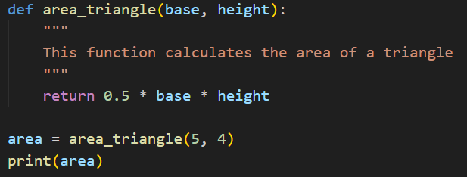
Where does a program start?
Other languages have “main”, “main” is effectively the first line that is not a function declaration. (Function declarations are not part of the sequential execution)
Notes:
We’ll be calling the code not in a function definition the code in “main” for simplicity

Slide 24
Calling Functions
def first(a):
a = 8
return a
a = 20
first(a)
print(a)
What is the output of the print call at the bottom of this code?
8
20
8
20
Error, because “a” can’t be assigned in two places
0
Notes:
Draw memory models

Slide 25
Calling Functions
def first(a):
a = 8
return a
a = 20
a = first(a)
print(a)
What is the output of the print call at the bottom of this code?
8
20
8
20
Notes:
Draw memory models

Slide 26
Choosing Parameters
How do you decide on the parameters of a function?
Ask the question:
“What does the function need to know to do its job?”
Style rule: Everything a function has to “know” should be provided as a parameter
Function can access:
Local variables (including parameters)
Global variables (often bad style)
Built-in functions/variables (e.g., abs)
But not parameters and variables of other functions!

Slide 27
Calling Functions
def a(num):
return val + num + 3
def b(val):
return a(1)
print(b(2))
What is the output of this code?
6
7
4
5
Error because of an undefined variable
Notes:
Draw memory models

Slide 28
Calling Functions
def a(num, val):
return val + num + 3
def b(val):
return a(1, 1)
print(b(2))
What is the output of this code?
6
7
4
5
Error because of an undefined variable
Notes:
Call out that a(1,1) is bad form because it doesn’t use the parameter val!
Draw memory models

Slide 29
Returning from a function
def first(val):
return val
def second(val):
print(val)
Which of the functions returns val?
first
second
both
neither
Notes:
Just first! Addresses common misconception that confuses “printing” with “returning”

Slide 30
Return vs. print
We have said that return terminates the function and returns a value to its caller
If there is no return, the function returns the value None
We have also used the print function, which outputs its arguments to the screen
print takes arguments and prints them out with a space separating the values
print as a function itself actually returns None

Slide 31
Todo List
Complete HW0 (on canvas) due next Wednesday:
Complete the syllabus quiz (#FinAid) on canvas
Complete the Academic Integrity Agreement Form
Complete “setting up your environment” and submit on gradescope
Also complete the “Practice Lab Exercise” to make sure Copilot is working for you on PrairieLearn for lab next Wednesday.
There’s also a check to make sure Copilot is working for your lab Wed.
Complete the “Pre-Class Getting to know you survey”
Attend Lab tomorrow in your assigned section
May need your student ID and could be helpful to have your laptop
Arrive 5 minutes early to ensure you can start the lab on time
Can start homework 1, but more details provided in the lab on Wednesday and class Thursday
Notes:
Mention extension

